Slide 1
The Pi-Man Project
Raspberry Pi at the University of Manchester
Linux introduction labs from
the perspective of a student

Slide 2
Linux for Dummies

Slide 3
Knowledge is not assumed
    Computing is not a widely available A-level
    Computer science is taught with the assumption of no former programming knowledge
The same for Linux
  Linux is dual-booted alongside the University-standard windows 7 OS
  Students are expected to use Linux for almost all of their Computer Science work
  About half the students haven't used Linux and of those who have, less than half consider themselves to be proficient.
  Again, no knowledge of Linux is assumed

Slide 4
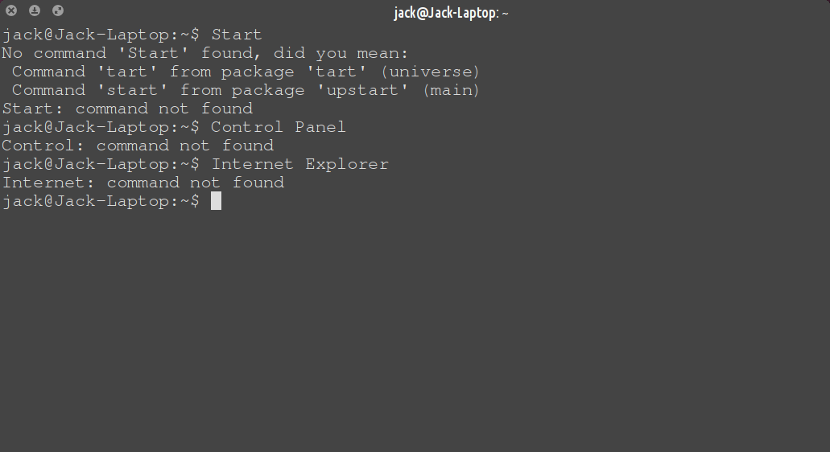
1 week Linux crash course
  Taught over 4 labs, a total of 8 hours.
  Covers the basic Unix commands, file system
  and setup of window manager and other dotfiles
?

Slide 5
WARNING! DO NOT ACTUALLY TRY THIS!
We once had a system administrator who, after logging in as the superuser, typed the above command by accident.
sudo rm -rf /

Slide 6
£15,000 of Pi

Slide 7
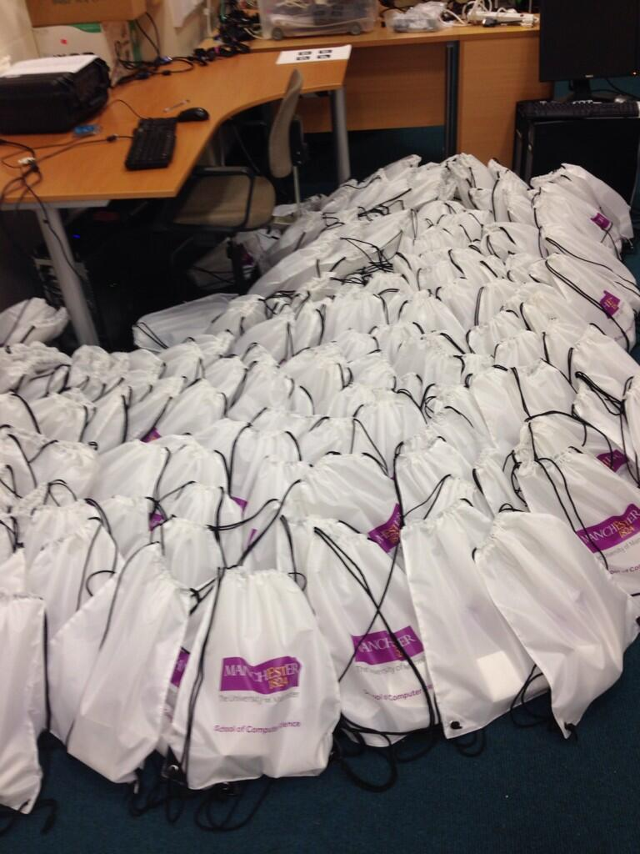
The Costs
Raspberry Pis - £7000
Lab infrastructure - £5000
Vacation students - £3000

Slide 8
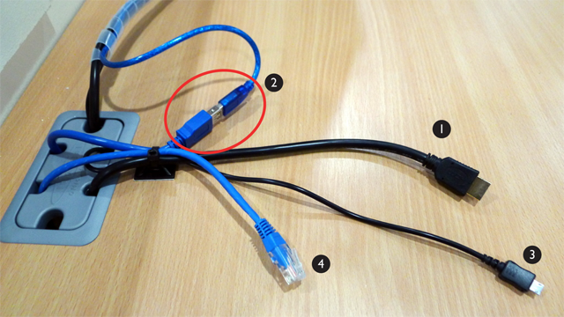
Infrastructure
1 – HDMI display
2 – USB hub cable
.
3 – MicroUSB power
4 – Ethernet
Keyboard and mouse connected to a USB
hub in the monitor, In-line connector to easily
switch between devices
Not allowed to install more plug sockets in
the lab, so a 12V audio output on the monitor
is adapted using an in-car power supply
Not raspberry red. Unforgivable.

Slide 9
Have Quake and eat it

Slide 10


Slide 11
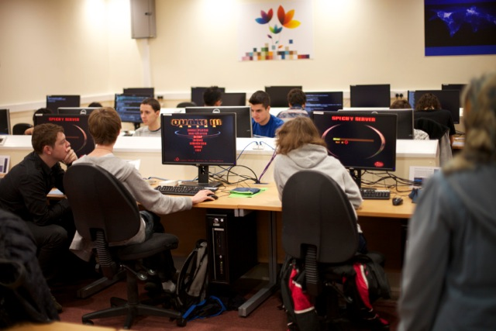

Slide 12
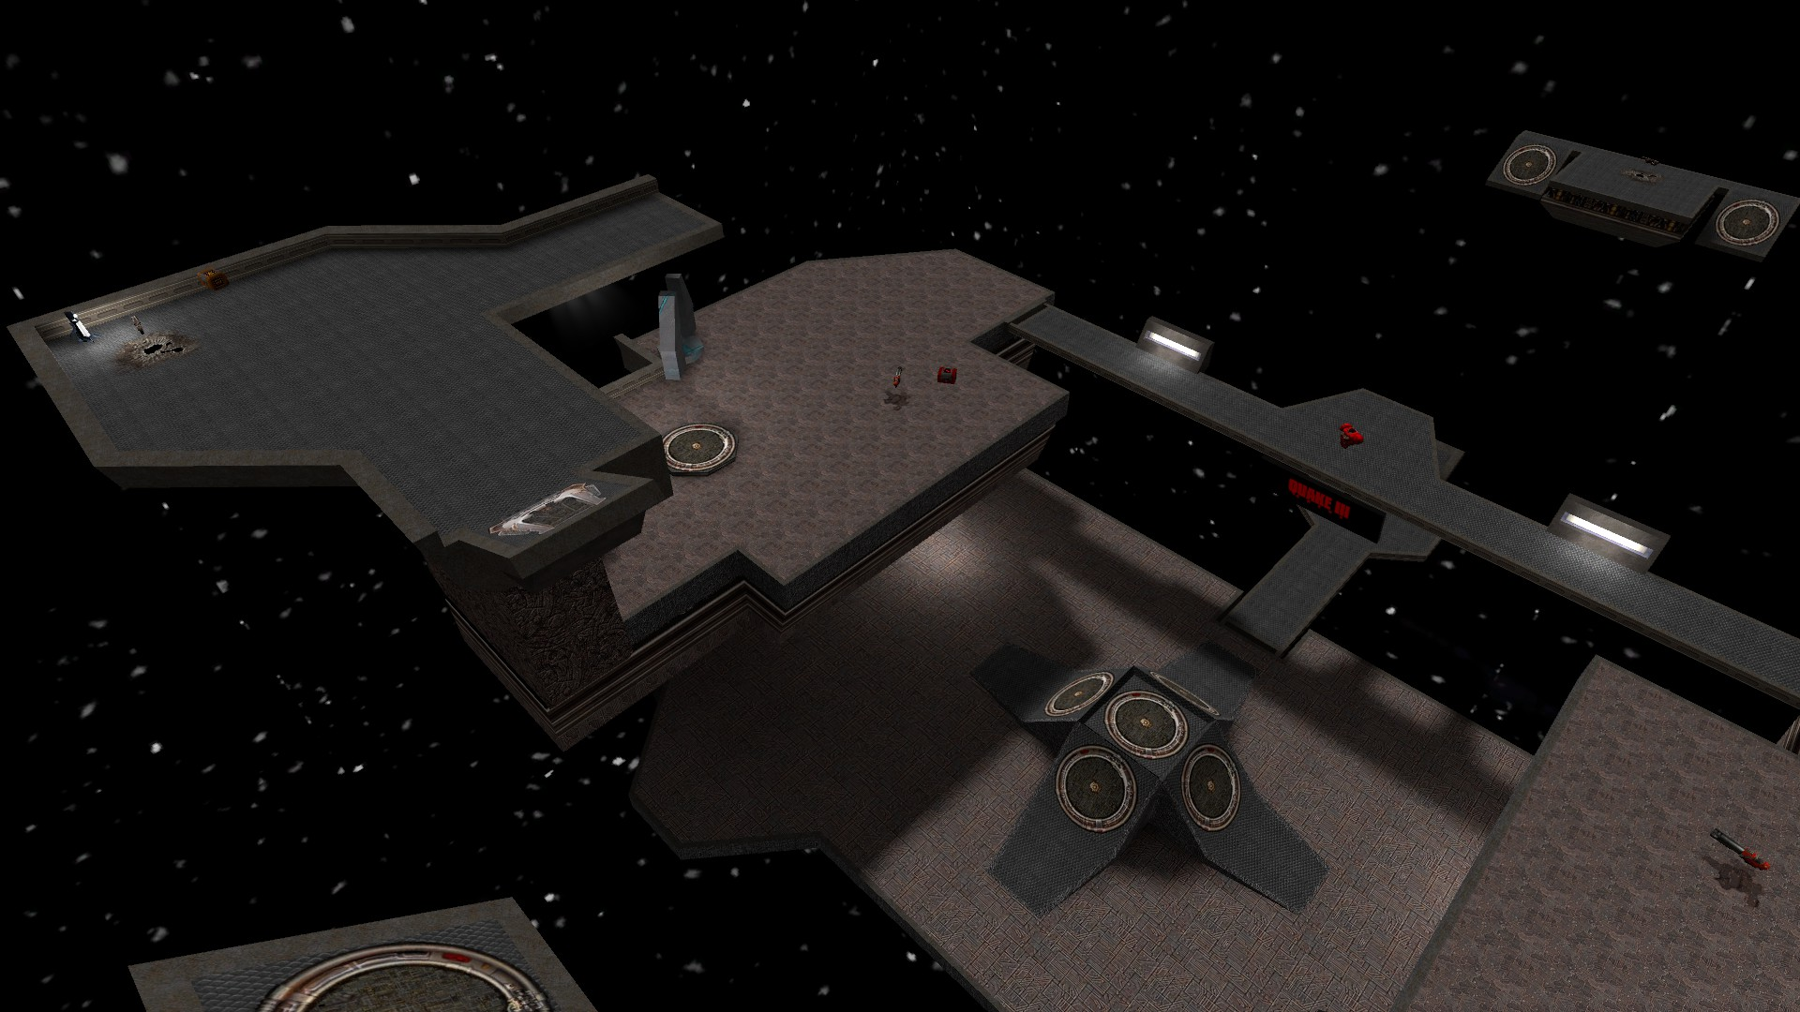

Slide 13
Finally...
Any Questions?

Slide 14
If you'd like to learn more about the Pi-Man project you can Read Steve Pettifer's blog posts about the project at rougepointer.net
Inflate my twitter ego:
@SecretImbecile

